Slide 1
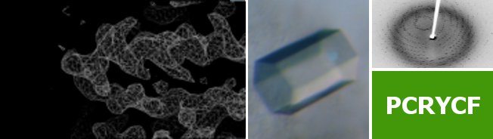
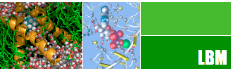


State of the art of protein tertiary structure prediction
Luciano Abriata and Matteo Dal Peraro
Protein Production & Structure Facility
Laboratory for Biomolecular Modeling
http://labriataphd.altervista.org/
Notes:
So, now it’s time to talk about NMR. This is a spectroscopy that you can do in solution or in solid state, but we’ll talk about applications to biological problems in solution. I do NMR for the facility in 30% of my working time, using the instrumentation maintained by ISIC.

Slide 2
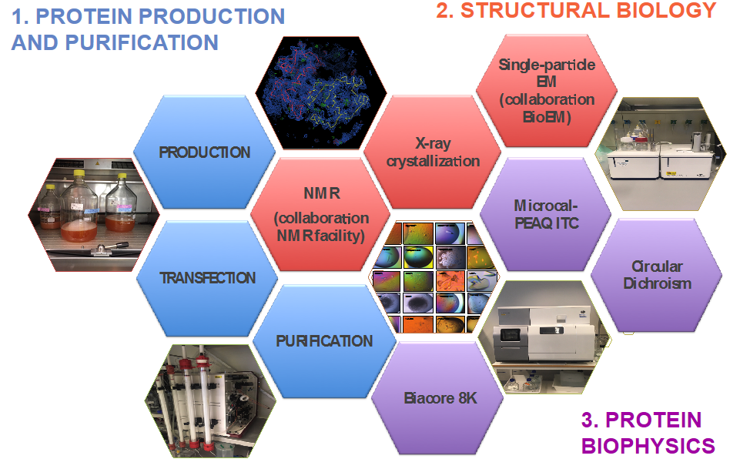
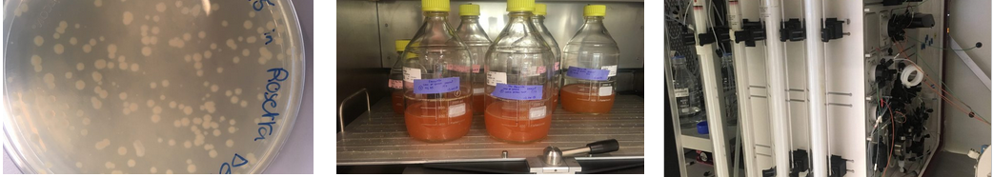
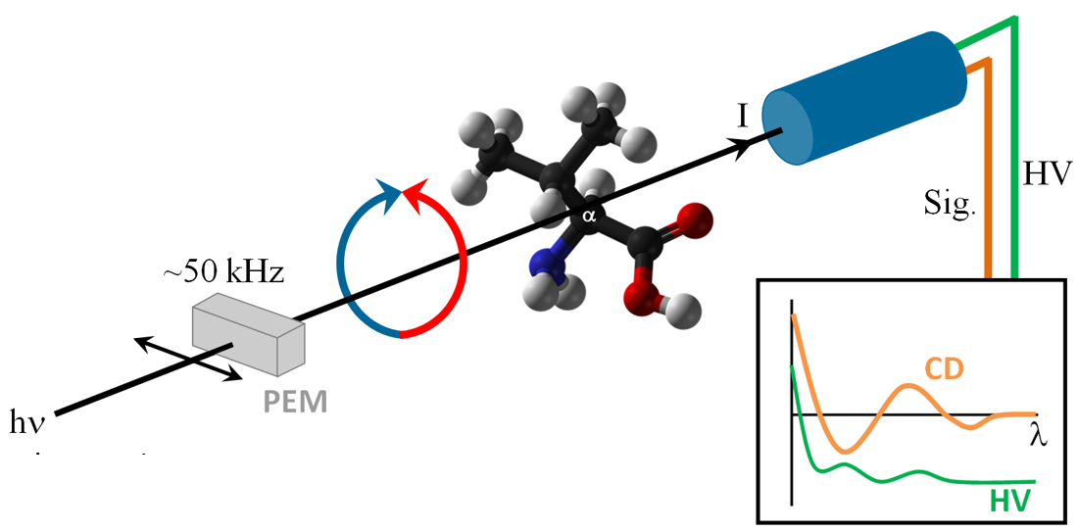
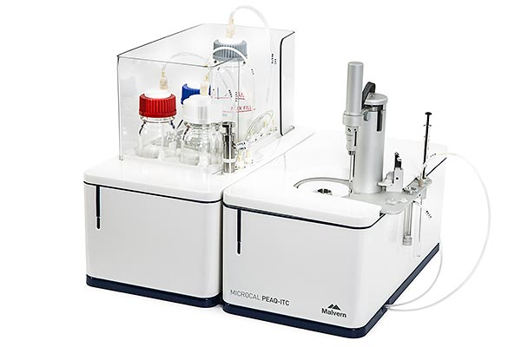
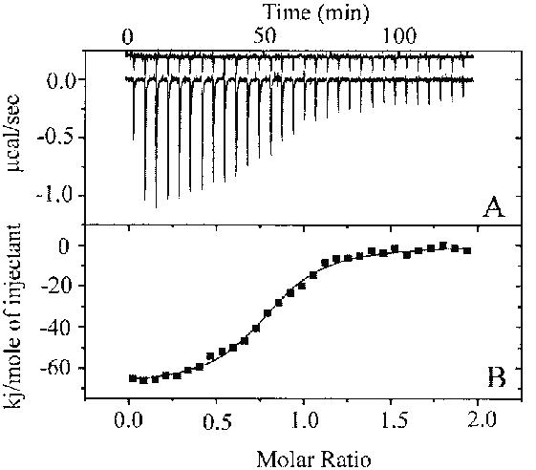
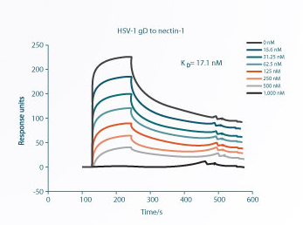
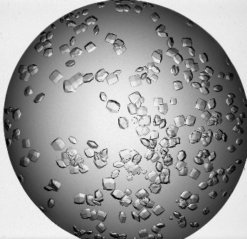
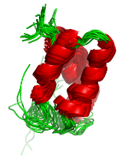
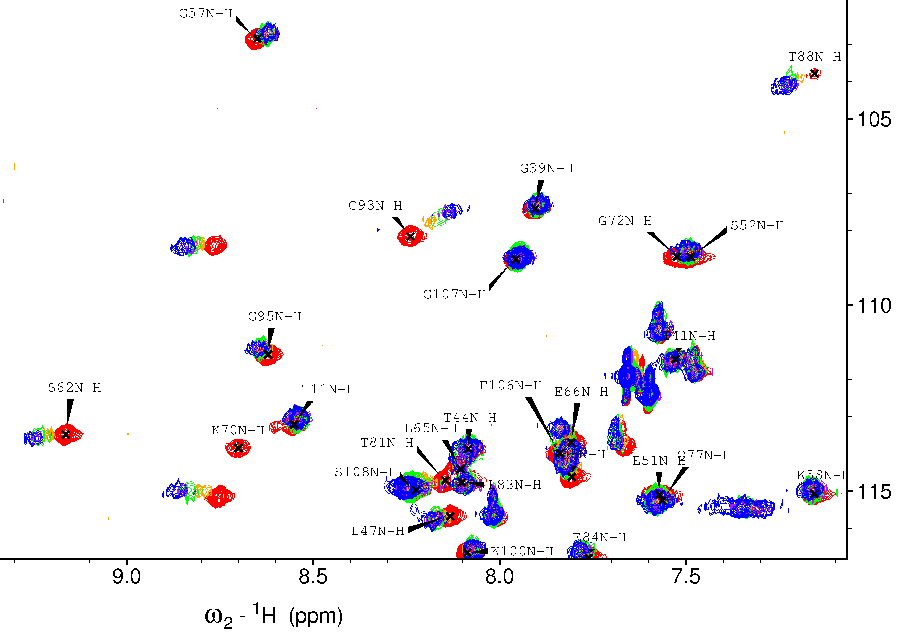
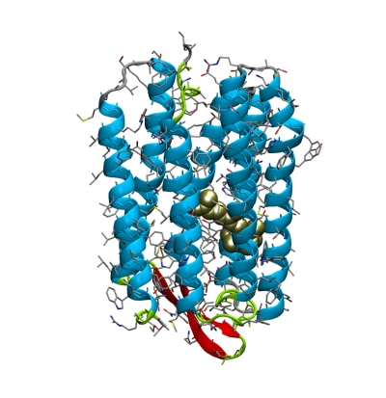
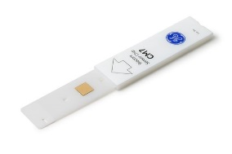
Protein Production and Structure Facility
CD
ITC
NMR
SPR
XRD
Notes:
1) We have all the instrumentation and know-how to produce proteins expressed in bacterial, insect and mammalian cells.
2) We purify and teach users to purify proteins, and to analyze protein samples by CD, ITC and SPR.
3) We also offer advice on other possible biophysical techniques in collaboration with other facilities and labs.
4) We design and perform protein crystallization trials, to get crystals that we then shoot at SLS for structure determination.
5) We advice and execute NMR-based investigations of proteins in solution.
6) We also help you prepare grids for electron microscopy

Slide 3
State of the art of protein tertiary structure prediction
Luciano Abriata and Matteo Dal Peraro
Protein Production & Structure Facility
Laboratory for Biomolecular Modeling
http://labriataphd.altervista.org/
Notes:
So, now it’s time to talk about NMR. This is a spectroscopy that you can do in solution or in solid state, but we’ll talk about applications to biological problems in solution. I do NMR for the facility in 30% of my working time, using the instrumentation maintained by ISIC.

Slide 4
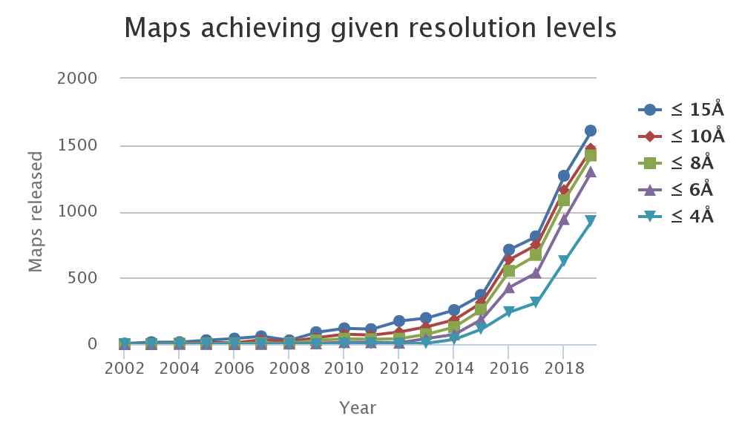

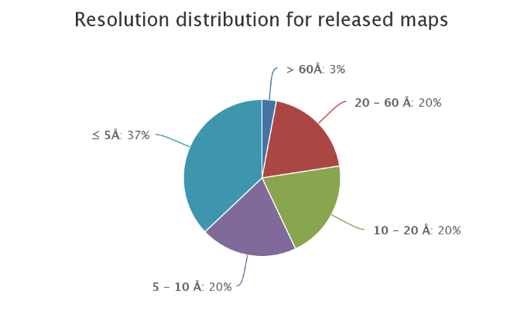
Computer-based protein modeling in structural biology
Protein dynamics
Protein design
…
Exp. data analysis
Virtual screening
Structure prediction
Structure prediction is useful for molecular replacement, for docking in low-resolution maps, even by itself…
http://labriataphd.altervista.org/

Slide 5
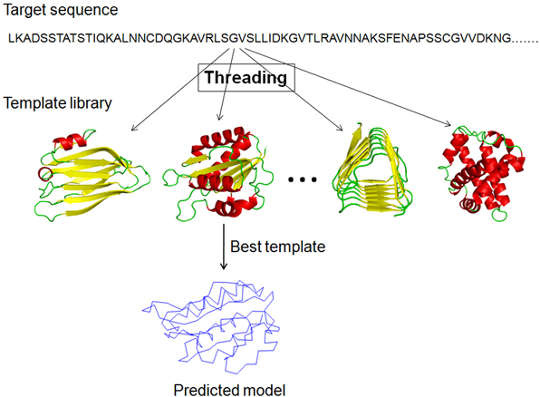
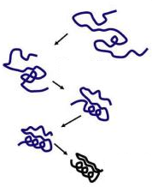
Building models of proteins of unknown structure
Homology modeling
Ab initio prediction
Template detection
Threading
Finding structurally similar template at PDB
Correctly aligning sequences
Threading
Physics- or Data- based conformational potential
Sampling capacity
Scoring to detect folded structure
External data?
http://labriataphd.altervista.org/

Slide 6
How good are structure predictions, especially when lacking templates for homology modeling?
CASP
Critical Assessment of Structure Prediction
Multiple tracks: topology (tertiary structure) – quaternary structure – etc.
Dedicated issues in Proteins: Structure, Function and Bioinformatics
For reusability and transparency, we contributed a fully web-based interface for model evaluation
http://labriataphd.altervista.org/

Slide 7
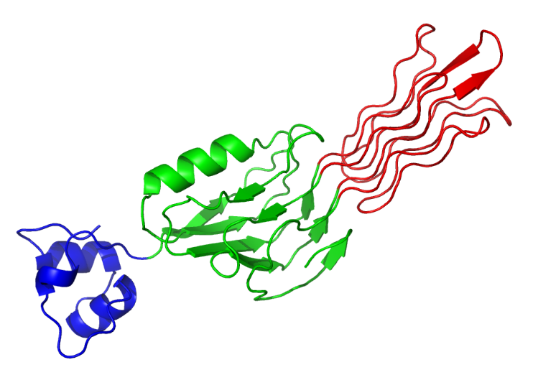
T0892-D1
T0892-D1
T0894-D2
T0890-D1
T0907-D1
T0876-D1
T0868-D1
T0909-D1
T0894-D2
T0907-D2
T0945-D1
T0890-D1
T0876-D1
T0907-D1
Average GDTTS of top 20 servers
T0912-D2
T0945-D1
T0907-D2
Average GDTTS of top 20 servers
T0943-D1
T0909-D1
T0901-D1
T0943-D1
T0868-D1
T0896-D2
T0912-D2
T0901-D1
T0874-D1
T0898-D2
T0884-D1
T0896-D2
T0875-D1
T0875-D1
T0887-D1
T0896-D1
T0887-D1
T0898-D2
T0874-D1
T0896-D1
CASP targets have domains of varying difficulty
T0884-D1
Easily findable templates for homology modeling
Intermediate situation
No good templates for homology modeling
Average GDTTS of top 20 servers
(HHpred score + LGA score) / 2
http://labriataphd.altervista.org/

Slide 8
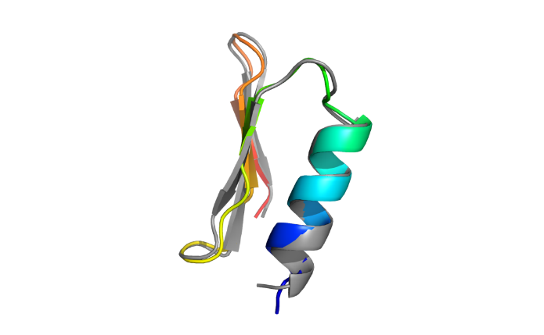
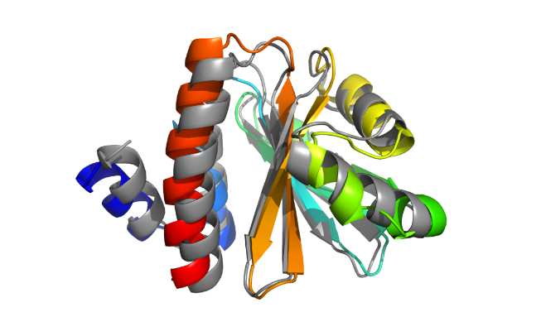
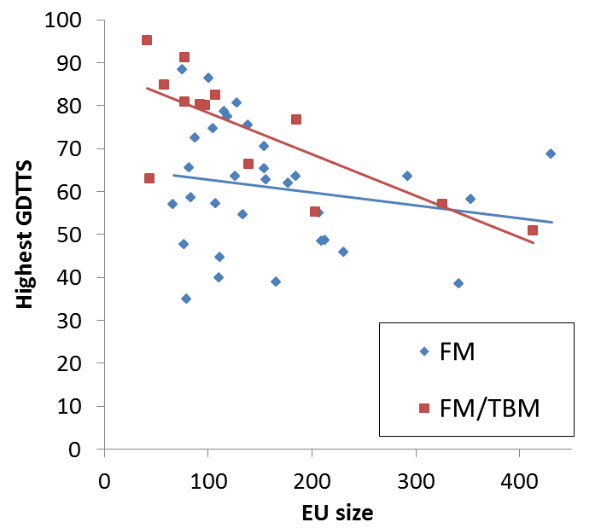
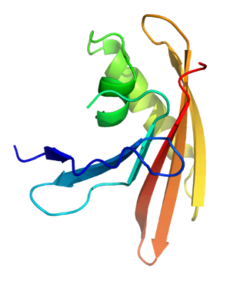
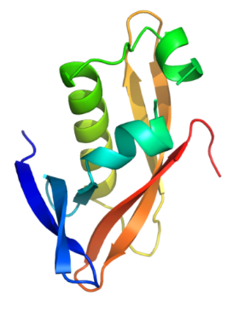
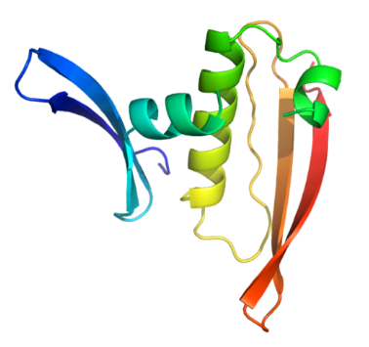
Evaluating predictions of hard and very hard domains
For small proteins there is very good chance of capturing topology, and even some chance of getting quite good models
Very hard = no template at all
Hard = template hard to find or structurally divergent
Number of residues
http://labriataphd.altervista.org/

Slide 9
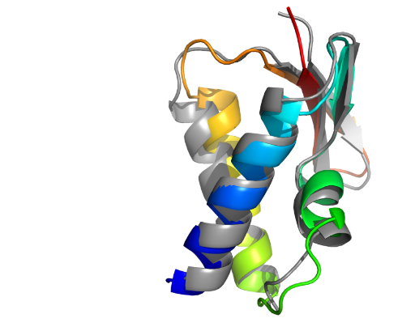
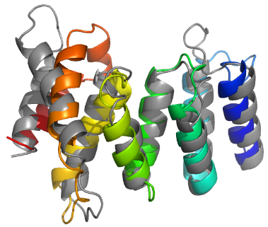
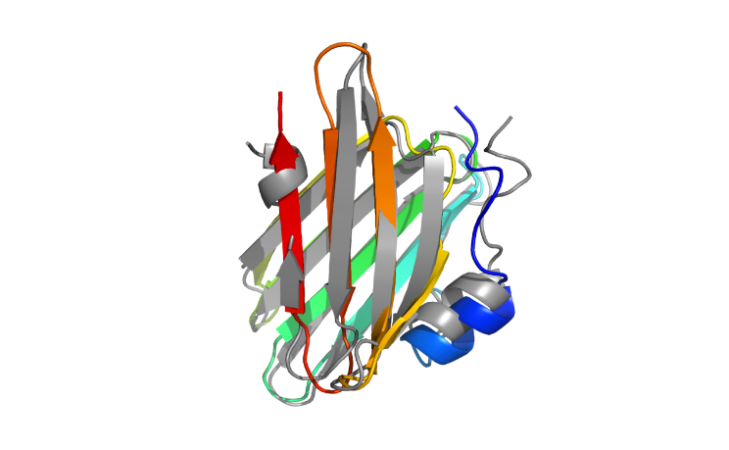
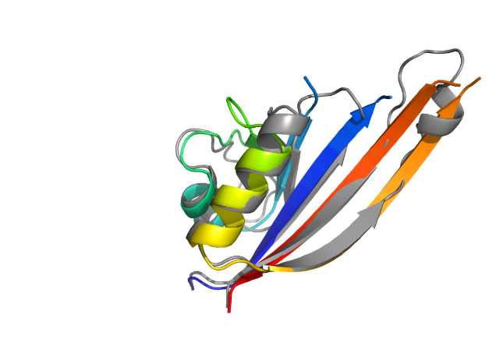
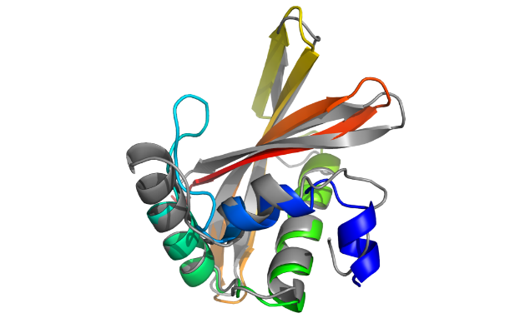
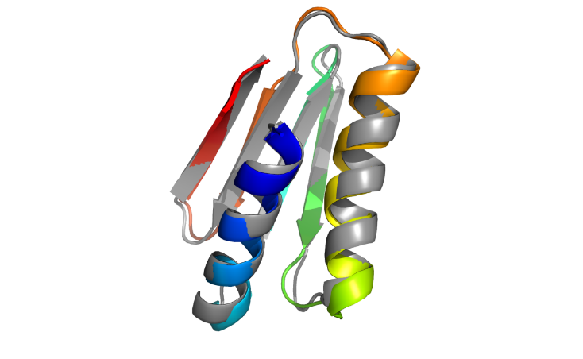
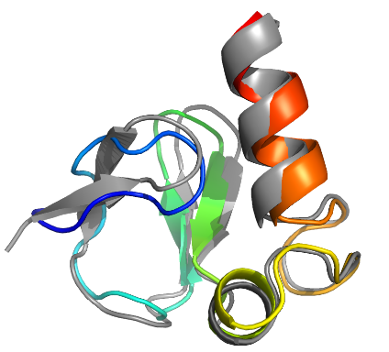
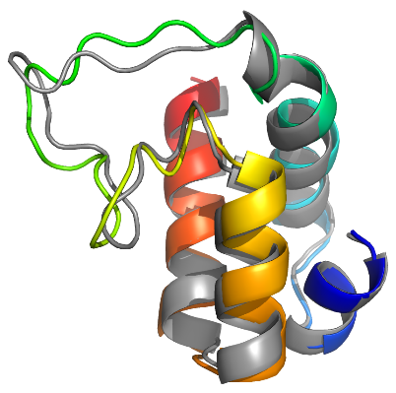
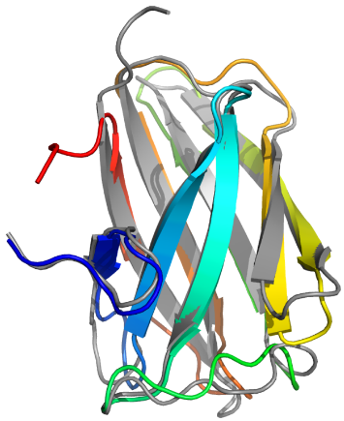
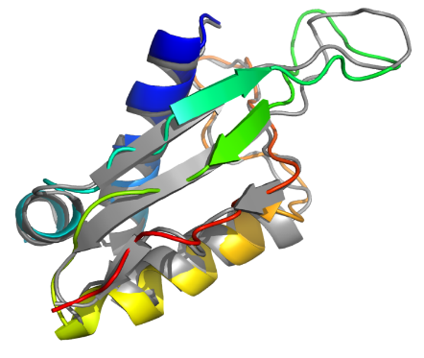
T0955-D1 (FM/TBM)
41 residues
T0957s2-D1 (FM)
154 residues
T0958-D1 (FM/TBM)
77 residues
TS441_2-D1 (219 models)
TS043_5
& TS043_1
TS431_1-D1 (32 models)
0.98 Å over full sequence
< 2.3 Å over 85% of the sequence
1.73 Å over full sequence
HHscore 19.46
LGA 93.4
Neff/L HHblits 0.02
HHscore 10.7
LGA 51
Neff/L HHblits 0.17
HHscore 48
LGA 69
Neff/L HHblits 0.39
T0968s1-D1 (FM)
118 residues
T0968s2-D1 (FM)
115 residues
T0970-D1 (FM/TBM)
96 residues
TS222_3-D1 (48 models)
TS043_1-D1 (12 models)
TS043_2-D1
(5 models plus 4 from TS347)
2.81 Å over full sequence
2.33 Å over full sequence
2.78 Å over 89% of sequence
HHscore 4.2 !
LGA 48
Neff/L HHblits 0.42
HHscore 19
LGA 50
Neff/L HHblits 1.23
HHscore 17
LGA 67
Neff/L HHblits 1.61
T1001 (FM)
139 residues
T1008 (FM/TBM)
77 residues
T1019s1-D1 (FM/TBM)
58 residues
TS222_4-D1 (106 models)
TS281_1-D1 (126 models)
TS043_2-D1 (85 models)
2.32 Å over full sequence
1.14 Å over full sequence
1.7 Å over full sequence
HHscore 11
LGA 55
Neff/L HHblits 0.04
HHscore 61
LGA 74
Neff/L HHblits 0.01
HHscore 48
LGA 54
Neff/L HHblits 10.26
T1021s3-D2 (FM)
101 residues
T0990-D1 (FM)
76 residues
T0992-D1 (FM/TBM)
107 residues
TS043_3-D2
(3 models)
TS274_2-D1 (118 models)
TS274_2-D1 (118 models)
1.65 Å over 95% of the sequence
1.6 Å over 95% of sequence
1.6 Å over 95% of sequence
HHscore 3.6
LGA 55
Neff/L HHblits 0.47
HHscore 2.4 !
LGA 56
Neff/L HHblits 0.51
HHscore 2.6 !
LGA 75
Neff/L HHblits 0.68

Slide 10
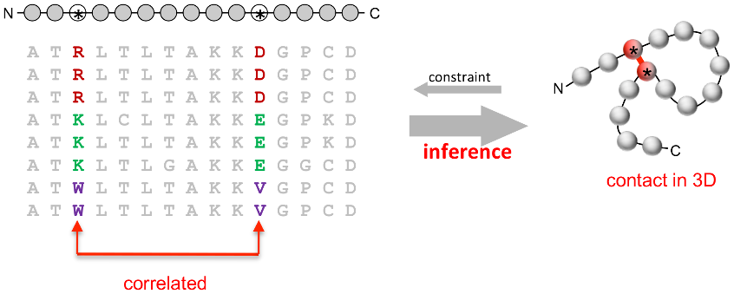
Progress in modeling very hard targets?
Machine Learning for molecular modeling
Coevolution-based contact prediction methods in literature
(1994)
(2018)
http://labriataphd.altervista.org/

Slide 11
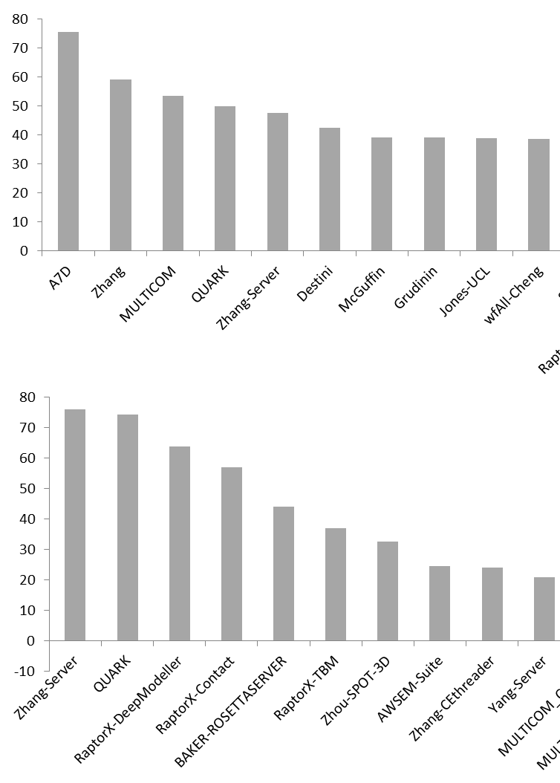
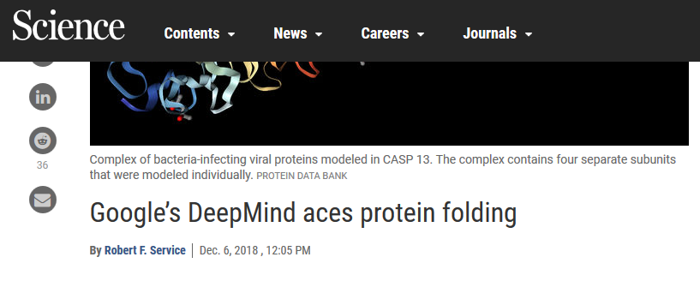

Official CASP13 (2018) ranking on very hard targets
Official ranking for all groups i.e. humans + servers
Sum of Z-scores
Official ranking for servers only
Sum of Z-scores
http://labriataphd.altervista.org/

Slide 12
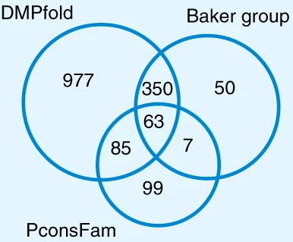
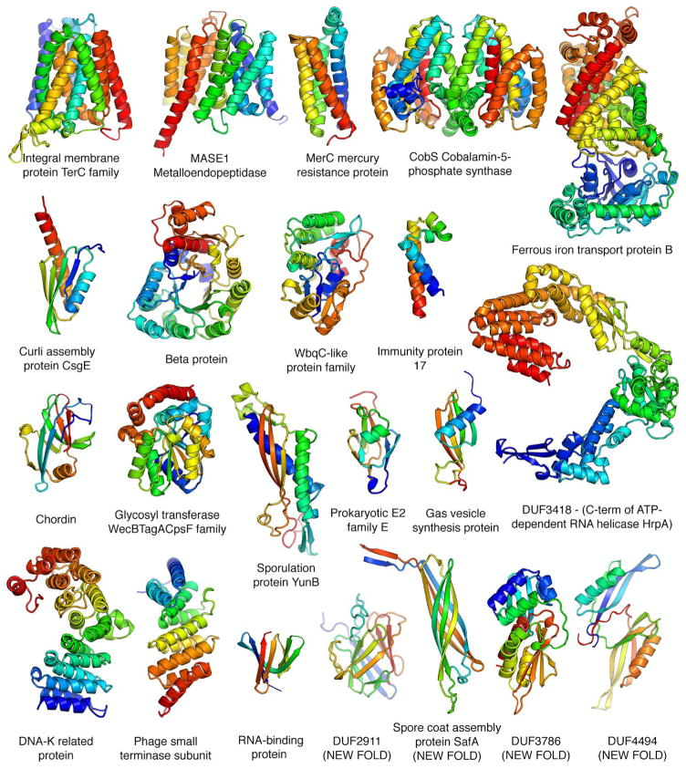
What’s in for you?
Use “CASP-certified” servers
Reuse contact-assisted models
Ovchinnikov Science 2017
Greener et al Nat Comm 2019
PFAM
Lamb et al J Mol Biol 2019
Dataset includes >130 new folds
http://labriataphd.altervista.org/

Slide 13
What’s in for you?
Paper SI
CASP models
SASBDB
etc…
Contact prediction-based models
PDB-Dev
>your_protein
PRTEINSEQENCE
http://labriataphd.altervista.org/
→ Follow modelsearch link
Models

Slide 14


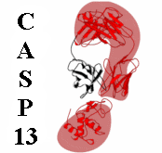



Acknowledgements
EPFL’s LBM @CASP
M Dal Peraro, G Tamó
CASP
J Moult, T Schwede, A Kryshtafovych
>your_protein
PRTEINSEQENCE
http://labriataphd.altervista.org/
→ Follow modelsearch link
Models
Want to help make predictions better? Share your structure with CASP! (yes, it’s safe!)

